Slide 1
Configuration

Slide 2
Agenda
Why do we need configuration files?
How to read and write configuration files
Default configuration

Slide 3
Why do we need configuration files?
Notes:
Re-cap on some of the material from last time.
We need a way to build different versions of software.

Slide 4
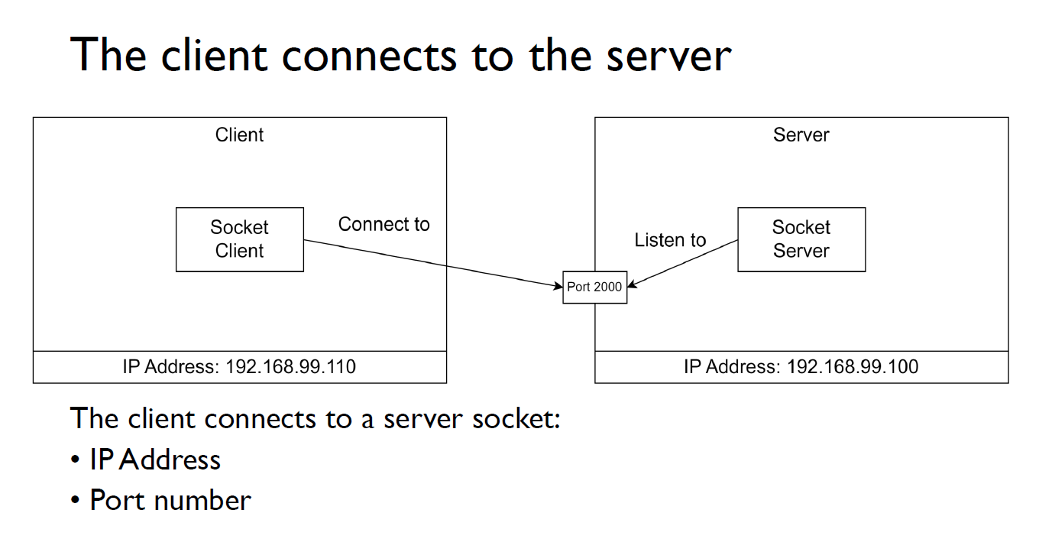
Application configuration

Slide 5

Simple Factory – an example
1 application library containing all code, referenced by 1 application project which is configured by 5 individual text files
HospitalBed.exe
HospitalBed.exe
HospitalBed
HospitalBed.
Application
HospitalBed.exe
HospitalBed.dll
HospitalBed.exe
Nordjylland.txt
HospitalBed.exe
Filter: Raw
Alarm: Buzzer
Filter: Raw
Alarm: SMS
Hovedstaden.txt
Midtjylland.txt
Filter: 3-sample
Alarm: Email
Filter: 3-sample
Alarm: Light
Sjælland.txt
Sydjylland.txt
Filter: 3-sample
Alarm: SMS
Notes:
Re-cap from last weeks lesson in factories.

Slide 6
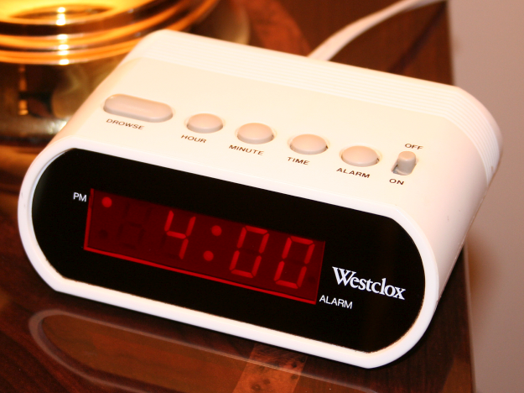
Or simply user settings
Notes:
Also, sometimes, the user is allowed to configure our software and we don’t want to do that every time the program starts.

Slide 7
Ways to work with configuration in .NET
System.Configuration
Read and write key/value pairs in Web.Config or App.Config (xml files)
XMLSerializer
Serialize and de-serialize objects to XML
data is organized as a tree
JsonSerializer
Serialize and de-serialize objects to JSON
data is organized as objects
Microsoft.Extensions.Configuration
File format can be JSON, XML, ini or custom
all configuration is read as keys/value pairs
can’t write to files... ☹
Notes:
System.Configuration is the old/classic way of accessing key/value pairs in xml files.
Microsoft.Extensions.Configuration has been developed in the ASP.NET Core context and is a great way of accessing configurations in multiple formats. Unfortunately, there is no support for writing to the configuration files.
XMLSerializer can create an XML file from an object graph and load it back into the objects.
DataContractJsonSerializer can also load/save an object graph.
https://www.codeproject.com/Articles/1173468/Four-Ways-to-Read-Configuration-Setting-in-Csharp
http://codesamplez.com/programming/serialize-deserialize-c-sharp-objects
https://docs.microsoft.com/en-us/dotnet/framework/wcf/feature-details/how-to-serialize-and-deserialize-json-data
https://docs.microsoft.com/en-us/aspnet/core/fundamentals/configuration?tabs=basicconfiguration

Slide 8
Structuring the configuration
[Information]
AppName = Configuration Demo ini
[UserSettings]
TimeFormat = 24
INI files:
Single level of grouping.
{
“Information” : {
"AppName" : "Configuration Demo Json“
},
“UserSettings” : {
“TimeFormat” : 24
}
}
Json:
A tree, in the form of object nested in objects.
<root>
<Information>
<AppName>Conf Demo XML</AppName>
</Information>
<UserSettings>
<TimeFormat>24</TimeFormat>
</UserSettings>
</root>
XML:
A tree, in the form of xml tags inside xml tags.

Slide 9
JsonSerializer

Slide 10
JsonSerializer – Configuration object
public class AlarmSettings { public enum TimeFormatEnum { H12, H24 }
public TimeFormatEnum TimeFormat { get; set; } public bool AlarmIsOn { get; set; } public string Locale { get; set; } }
The XMLSerializer can be used to save/load an object graph.
Create an object with public properties.
There must be a parameterless constructor. But you can add other constructors.
{
"TimeFormat":0,
"AlarmIsOn":false,
"Locale":"DK”
}

Slide 11
JsonSerializer – Save the configuration
public void Save(AlarmSettings alarmSettings,
string path)
{
string json =
JsonSerializer.Serialize(alarmSettings); File.WriteAllText(path, json);
}
Use the JsonSerializer to save the object as Json.
{
"TimeFormat":0,
"AlarmIsOn":false,
"Locale":"DK”
}

Slide 12
JsonSerializer – Load the configuration
public AlarmSettings Load(string path)
{
string text = File.ReadAllText(filename); AlarmSettings alarmSettings =
JsonSerializer.Deserialize<AlarmSettings>(text);
return alarmSettings;
}
Use the JsonSerializer to load the object from Json.
{
"AlarmIsOn":true,
"Locale":"US",
"TimeFormat":0
}

Slide 13
JsonSerializer – Lists
public class NestedConfigurations {
... public List<AlarmSettings> alarms { get; set; }
... }
Lists can also be serialized.
[
{
"TimeFormat":0,
"AlarmIsOn":false,
"Locale":"DK”
},
{
"TimeFormat":1,
"AlarmIsOn":true,
"Locale":"DK”
}
]

Slide 14
JsonSerializer - Attributes
public class AlarmSettings { public enum TimeFormatEnum { H12, H24 }
public TimeFormatEnum TimeFormat { get; set; }
[JsonPropertyName("IsOn")] public bool AlarmIsOn { get; set; }
public string Locale { get; set; }
[JsonIgnore]
public bool snoozed {get; set; } }
Attributes can be used to change the Json element name or ignore a class field.
{
"IsOn":true,
"Locale":"US",
"TimeFormat":2
}
https://docs.microsoft.com/en-us/dotnet/standard/serialization/controlling-xml-serialization-using-attributes

Slide 15
JsonSerializer – Error handling
The JsonSerializer throws an exception, if the Json can’t be de-serialized to the object graph.
You need to handle this in the code.
A good way:
Provide the user with an error message, create a valid configuration file, which the user can modify and exit the program.
Don’t overwrite the bad configuration file.
Create something like ”hospitalbed.config.default” instead.
Notes:
Don’t overwrite:
The bad file may just be a little malformed and the user may have spent a long time configuring the application. You don’t want to throw that away, just because of a spelling error or a missing end tag.
Also, the default configuration may NOT be what a user wants.

Slide 16
XMLSerializer

Slide 17
XMLSerializer – Save the configuration
public static void Save(Configuration configuration,
string path)
{
FileStream fs = new FileStream(path, FileMode.Create);
XmlSerializer serializer =
new XmlSerializer(typeof(Configuration));
serializer.Serialize(fs, configuration);
fs.Close();
}
Use the XMLSerializer to save the object as XML.
<?xml version="1.0"?>
<Configuration xmlns:xsi="http://www.w3.org/2001/XMLSchema-instance" xmlns:xsd="http://www.w3.org/2001/XMLSchema">
<TimeFormat>H24</TimeFormat>
<AlarmIsOn>false</AlarmIsOn>
<Locale>US</Locale>
</Configuration>

Slide 18
XMLSerializer – Load the configuration
public static Configuration Load(string path)
{
FileStream fs = new FileStream(path,
FileMode.Open);
XmlSerializer serializer =
new XmlSerializer(typeof(Configuration));
Configuration configuration =
(Configuration)serializer.Deserialize(fs);
fs.close();
return configuration;
}
Use the XMLSerializer to load the object from XML.
<?xml version="1.0"?>
<Configuration xmlns:xsi="http://www.w3.org/2001/XMLSchema-instance" xmlns:xsd="http://www.w3.org/2001/XMLSchema">
<TimeFormat>H24</TimeFormat>
<AlarmIsOn>false</AlarmIsOn>
<Locale>US</Locale>
</Configuration>

Slide 19
XMLSerializer – Lists
public class NestedConfiguration
{
...
public List<AlarmConfiguration> Alarms { get; set; }
= new List<AlarmConfiguration>();
...
}
public class AlarmConfiguration
{
public AlarmConfiguration()
{
}
public int Hour { get; set; }
public int Minute { get; set; }
public bool Active { get; set; }
}
Lists can also be serialized.
<?xml version="1.0"?>
<NestedConfiguration xmlns:xsi="http://www.w3.org/2001/XMLSchema-instance" xmlns:xsd="http://www.w3.org/2001/XMLSchema">
<Alarms>
<AlarmConfiguration>
<Hour>6</Hour>
<Minute>20</Minute>
<Active>true</Active>
</AlarmConfiguration>
<AlarmConfiguration>
<Hour>6</Hour>
<Minute>30</Minute>
<Active>false</Active>
</AlarmConfiguration>
</Alarms>
</NestedConfiguration>

Slide 20
XMLSerializer - Attributes
public class TaxRates{
[XmlElement(ElementName = "TaxRate")]
public decimal ReturnTaxRate;
// The XmlSerializer ignores this field.
[XmlIgnore]
public string Comment;
}
Attributes can be used to change the XML element name or ignore a class field.
https://docs.microsoft.com/en-us/dotnet/standard/serialization/controlling-xml-serialization-using-attributes

Slide 21

Your turn
Solve the exercises

Slide 22

Extra stuff – just for informational purpose!

Slide 23
Microsoft.Extensions.Configuration

Slide 24
Microsoft.Extensions.Configuration
Installation through NuGet package manager.
Install-Package Microsoft.Extensions.Configuration -Version 5.0.0
Install-Package Microsoft.Extensions.Configuration.FileExtensions -Version 5.0.0
Install-Package Microsoft.Extensions.Configuration.Json -Version 5.0.0
Install-Package Microsoft.Extensions.Configuration.Xml -Version 5.0.0
Install-Package Microsoft.Extensions.Configuration.Ini -Version 5.0.0
Install-Package Microsoft.Extensions.Configuration.Binder -Version 5.0.0

Slide 25
Key/Value access
var applicationName = configuration["AppName"];
Console.WriteLine("Application name is {0}", applicationName);

Slide 26
Reading a JSON file
class JsonConfiguration
{
public void ReadConfiguration()
{
var configurationBuilder = new ConfigurationBuilder();
var currentDirectory = Directory.GetCurrentDirectory();
string configPath = Path.Combine(currentDirectory,
"ConfigurationDemo.json.config");
IConfigurationRoot configuration = configurationBuilder
.AddJsonFile(configPath, optional: false)
.Build();
var applicationName = configuration["AppName"];
Console.WriteLine("Application name is {0}",
applicationName);
}
}
{
"AppName" : "Configuration Demo Json"
}

Slide 27
Reading an XML file
class XmlConfiguration
{
public void ReadConfiguration()
{
var configurationBuilder = new ConfigurationBuilder();
var currentDirectory = Directory.GetCurrentDirectory();
string configPath = Path.Combine(currentDirectory,
"ConfigurationDemo.xml.config");
IConfigurationRoot configuration = configurationBuilder
.AddXmlFile(configPath, optional: false)
.Build();
var applicationName = configuration["AppName"];
Console.WriteLine("Application name is {0}",
applicationName);
}
}
<root>
<AppName>Conf Demo XML</AppName>
</root>

Slide 28
Reading an INI file
class IniConfiguration
{
public void ReadConfiguration()
{
var configurationBuilder = new ConfigurationBuilder();
var currentDirectory = Directory.GetCurrentDirectory();
string configPath = Path.Combine(currentDirectory,
"ConfigurationDemo.ini.config");
IConfigurationRoot configuration = configurationBuilder
.AddIniFile(configPath, optional: false)
.Build();
var applicationName = configuration["AppName"];
Console.WriteLine("Application name is {0}",
applicationName);
}
}
AppName = Configuration Demo ini

Slide 29
References and image sources
Images:
Alarm clock: https://upload.wikimedia.org/wikipedia/commons/e/eb/Digital-clock-alarm.jpg
Computer keyboard: http://stockmedia.cc/computing_technology/slides/DSD_8790.jpg
Bonus: http://wjreviews.com/reviews-cta/bonus.png

